Slide 1
KABADDI
Dr. Vivek B. Sathe
Assistant Professor (Senior Scale)
&
National Official
Ameteur Kabaddi Federation of India

Slide 2
Brief History
The word Kabaddi is derived from a Tamil word Kai-pidi, literally meaning "(let's) Hold Hands“.
It is the national game of Bangladesh, and the state game of Tamil Nadu, Punjab and Andhra Pradesh in India.
Kabaddi received international exposure during the 1936 Berlin Olympics,demonstrated by Hanuman Vyayam Prasarak Mandal, Amaravati, Maharashtra. The game was introduced in the Indian Olympic Games at Calcutta in 1938.
1950 - All India Kabaddi Federation.
1973 - Amateur Kabaddi Federation of India.
1978 - Asian Amateur Kabaddi Federation (AAKF)
2004 - Inter-national Kabaddi Federation (IKF)

Slide 3
Brief History
1980 - First Asian Kabaddi Championship
1990 - The game was included for the first time in the Asian Games in Beijing in 1990.
1990 - Gold Madel in Beijing Asian Games
1994 - Gold Madel in Hiroshima Asian Games
1998 - Gold Madel in Bangkok Asian Games
2002 - Gold Madel in Busan Asian Games
2006 - Gold Madel in Doha Asian Games
2010 - Gold Madel in Guangzhou Asian Games
2014 - Gold Madel in Incheon Asian Games (M&W)
(First time Women Kabaddi introduced in Incheon)

Slide 5
Play Ground
13 x 10 Meters for Men and Junior Boys
1 Meter LOBBY
1 M
1.75 M
1 M
3.75 Meters
Sitting Blocks
Mid Line
Baulk Line
Bonus Line
End Line
1 Meter LOBBY
Side Line
Official (Free) Area – 4 Meters

Slide 6
Play Ground
12 x 08 Meters for Women and Junior Girls
1 Meter LOBBY
1 M
2 M
1 M
3 Meters
Sitting Blocks
Mid Line
Baulk Line
Bonus Line
End Line
1 Meter LOBBY
Side Line
Official (Free) Area – 4 Meters

Slide 7
Play Ground
11 x 08 Meters for Sub-junior Boys and Girls
1 Meter LOBBY
1 M
1.5 M
1 M
3 Meters
Sitting Blocks
Mid Line
Baulk Line
Bonus Line
End Line
1 Meter LOBBY
Side Line
Official (Free) Area – 4 Meters

Slide 8
Age and Weight Categories
Ground - Ground shall be level and soft/Mat surface
Men and Junior Boys 13 X 10 Meters (as shown in the diagram).
MEN Below 85 Kg Weight
JUNIOR Boys: Age 20 years & below (last day of the year) and below 70 Kg weight
Women and Junior Girls 12 X 8 Meters (as shown in the diagram).
WOMEN Below 75 Kg Weight
JUNIOR GIRLS Age 20 years & below (last day of the year) and below 65 Kg Weight.
Sub-Junior Boys and Girls 11 X 8 Meters (as shown in the diagram).
SUB-JUNIOR BOYS Age 16 years & below (last day of the year) and below 55 Kg weight.
SUB-JUNIOR GIRLS Age 16 years & below (last day of the year) and below 55 Kg weight.

Slide 9
Terminology
Cant The repeated, without break; at a stretch and clear aloud sounding of the approved word “KABADDI” within the course of one respiration shall be called ‘Cant’.
Raider One who enters into the court of the opponent with the cant is known as a ‘RAIDER’. The raider must begin his cant before he touches the opponent’s court.
Anti or Anti-Raider Every player in whose court the raid is being made shall be called Anti or Anti Raider.
Loosing the Cant To stop the repeated and clear aloud sounding of the word KABADDI’ or take in a breath during cant by the raider is known as loosing the cant. A cant must be continued within one and the same respiration.

Slide 10
Terminology Cont..
Touch If the raider touches the anti or antis by any part of his body or even the clothing, shoes or any other outfit, it is called a touch.
Struggle When the anti or antis come into contact with the raider, it is called struggle. After touch or struggle the play field includes the lobbies.
Raid When the raider enters the court of opponent with cant, it is known as Raid.
Successful Raid When the raider crosses the Baulk line of the defending team at least once during the course of a raid and reaches his court with cant, it is known as Successful Raid.

Slide 11
Rules of Play
Toss - choice of the court or the raid. In the second half, the court shall be changed and the team, which did not, opted for raid shall send their raider first. The game in the second half shall continue with the same number of players, as it was at the end of the first half.
A player shall be out if any part of his body touches the ground outside the boundary but during the struggle a player shall not be out if any part of his body touches the ground outside the boundary by keeping contact of the playfield. The portion of contact must be inside the boundary.
If any player goes out of the boundary during the course of play, he shall be out. The Umpire or Referee shall try to take out such players at once. No whistle shall be blown as the raid may continue.
If an anti or antis who have gone out of bounds hold a raider, the raider shall be declared NOT OUT. The anti or antis who have gone out of bounds only will be declared out.

Slide 12
Rules of Play Cont..
When the struggle begins, the play field includes the lobbies.
A raider shall continue to chant “KABADDI” as the approved cant. If he is not keeping the proper approved cant in the opponent’s court, he shall be ordered back and the opponent will be given one technical point and chance to raid. Under such circumstances, he shall not be pursued.
A raider must start his cant before he touches the opponent’s court. If he starts the cant late, he shall be ordered back by the Umpire or Referee and the opponent will be given one technical point & a chance to raid.
If a raider goes out of turn, the Umpire or Referee shall order him to go back and a technical point will be given to opponent team.
Not more than one raider shall enter the opponent’s court at a time, if done than order all to go back to their court and a technical point.

Slide 13
Rules of Play Cont..
The opponents shall send their raider within 5 Seconds. In case the raider fails to start his raid within 5 seconds the team looses its chance to raid and the opponent team gets a technical point.
If a raider, who is caught by the anti or antis, escapes from their attempt to hold and reaches his court safely he shall not be pursued.
When a raider is held, the antis shall not try deliberately to stifle his cant by shutting his mouth, using violent tackling leading to injuries, any type of scissoring or use of any unfair means. If such incident happens, the Umpire or Referee shall declare the raider NOT OUT.
No anti shall willfully push the raider out of the boundary nor shall any raider willfully push or pull an anti out of the boundary. If done than the raider or the anti, as the case may be, NOT OUT, and the anti or the raider who pushes or pulls the opponents outside the boundary shall be declared out.

Slide 14
Rules of Play Cont..
If an anti or antis who are out, holds a raider, the raider shall be declared NOT OUT and the anti or antis who touches the raider’s court shall be declared OUT.
When a team manages to put out the entire opponent team and none of the opponents are entitled to be revived, then that team scores a LONA and two extra points for LONA shall be awarded. The play continues and all the players who are out shall enter in their court within Ten Seconds. Other wise the referee or umpire shall award one technical point to the opponent. If the team fails to enter within one minute, the team shall be scratched from the match and the match shall be awarded to the opponent.
If a raider is warned or in any way instructed by one of his own side, the Umpire or Referee shall award one technical point to the opponent.

Slide 15
Rules of Play Cont..
A raider or an anti is not to be held by any part of his body deliberately other than his limb or trunk. The one who violates the rule shall be declared OUT. If the raider is held deliberately other than his limb or trunk, the Umpire or Referee shall declare such raider NOT OUT.
Note
If a raider is caught by his clothes or hair the raider shall be declared NOT OUT and the anti or antis shall be declared OUT
When one or two players of a team are left during the game and the Captain of the team declares them out in order to bring in the full team, the opponent shall score as many points as the players that existed in the court at the time of declaration as well as Two Extra Points for LONA.
A Player or players who are out shall be revived in the same order as they were out when one or more opponents are out.

Slide 16
Rules of Matches
Team
Each team shall consist of minimum 10 and maximum 12 Players. 7 Players shall take the ground at a time and the remaining players are substitutes.
Duration of the match
Men & Junior Boys - 20-05-20
Women, Junior Girls, Sub-Junior Boys & Girls – 15-05-15
NOTE: The last raid of each half of the match shall be allowed to be completed even after completion of the scheduled time as mentioned above.

Slide 17
Rules of Matches
Time Out
a) Each Team shall be allowed to take Two “Time Outs” of 30 Seconds each in each half.
b) During the time out the teams shall not leave the ground, any violation in this; a technical point shall be awarded to the opponent team.
c) Official Time out can be called for by the Referee Umpire in the event of any injury to a player, interruption by outsiders, re-lining of the ground or any such unforeseen circumstances.
Substitution
Five Reserve Players can be substituted during time out or interval.
Substituted Players can be re-substituted.
If any player is suspended or disqualified from the match, no substitution is allowed for that particular player. The team will play with less number of players
No substitution is allowed during the official time out.
Substitution is not allowed for out players.

Slide 18
Rules of Matches
Bonus Point
a) One point shall be awarded to the raider when he crosses the bonus line.
b) The Bonus line will be applicable when there are minimum 6 players in the court.
c) If the raider while crossing the bonus line is caught then a point will be awarded to the defending team & No Bonus point shall be given.
d) The raider after crossing the bonus line if he puts out one or more antis, he will get the number of points scored in addition to the bonus point for crossing the bonus line.
e) No bonus point after a touch/struggle.
f) There shall be no revival for bonus point.
g) If player/players are suspended temporarily or disqualified from the match, then the team will play with less number of players. Such players shall be counted to award Bonus point.

Slide 19
Rules of Matches
Tie in Knock Out
1. Both the teams should field 7 Players in the Court.
2. Both teams should play the game on the baulk line.
3. The baulk line shall be treated, as Baulk Line Cum Bonus Line.
4. If the raider succeeds in crossing the baulk line cum bonus line he will get one point.
5. After crossing the Baulk line cum Bonus line, if the raider puts out one or more antis, he will get the number of points scored in addition to the one point scored.
6. The out or revival rule shall not be applicable, only points scored will be counted.
7. Both the teams should give the names of the five different Raiders with their Chest Numbers as per their order of raid to the referee. Substitution of players shall not be allowed from the fielded seven Players.

Slide 20
Rules of Matches
8. Each team shall be given 5 Raids by different raiders to raid alternately.
9. In case any raider in the given list of 5 raiders is injured before his chance of raid, in such cases, one of the remaining 2 players out of the seven in the field can do the raid.
10. The side, which raids first at the beginning of the match, shall be allowed to raid first
11. Even after 5 Raids, if there is a tie, the game will be decided as per the Golden Raid Rule.
N.B: If player/players are suspended temporarily or disqualified during the Tiebreaker, the team will play with less number of players. Such players shall be counted to award Bonus point.

Slide 21
Rules of Matches
Golden Raid
Even after 5-5 raids, if there is a tie, a fresh toss will be taken and the team that wins the toss shall have the chance to raid i.e. “GOLDEN RAID”
If there is tie even after the Golden Raid then a chance will be given to the opponent team for the Golden Raid.
In the Golden Raid the team which scores the leading point shall be declared as Winner.

Slide 22
Rules of Matches
Tie in league points
“For and Against Points” scored by using the following formula:
a) The team which scores less than 25% of the league points will not be considered for the “For and Against Points” formula.
b) To decide the tie, the “For and Against points” of the concerned teams against the teams which scored 25% or more of the league points will be considered and the difference calculated.
c) The team which is scoring highest score difference of “For and Against’ will be declared pool winner.
d) Even after considering “For and against” points, if there is a tie, the total points “SCORED FOR” only will be counted.

Slide 23
Rules of Matches
e) Even after this if there is a tie, the result of the match played between the teams is considered.
f) Even after this if there is a tie, the highest number of points scored without applying 25% rule shall be considered.
g) Even after this if there is a tie, the Winner and Runner will be decided on toss.
Note: Walkover is given to the opponent team by the referee due to late reporting, non-reporting or due to any other technical issues of the defaulting team. Such team will be scratched from the competition and the score of such teams shall not be considered to decide the tie. The same rule shall be applicable to teams which concede the match also.

Slide 24
Rules of Matches
If owing to failure of light, heavy rains or any other unforeseen circumstances, a match could not be completed in the same session; such a match shall be replayed in the next session. In case of replay, the players need not be the same for fielding a team.
In case of temporary suspension of the match - same score and remaining time in the same session. Players shall not leave their respective courts. If a team violates this rule a technical point will be awarded to the opponent team.
All players must have distinct numbers on their T-shirt of at least 4 Inches thickness in front and 6 inches thickness at the back.
Application of oils or any other soft substances to the body shall not be allowed.
Shoes are compulsory in case the match is played on the mat surface.

Slide 25
Technical Officials
1. One Referee
2. Two Umpires
3. One Scorer
4. Two Assistant Scorers

Slide 26
Technical Officials
Duties of the Referee
1) Take the toss
2) Announce the score of each side before the last 5 minutes is declared
3) Supervise in general, the conduct of the whole match.
4) Record the time, start and end the game
5) Announce the substitution & replacement of players.
6) Announce the time of each minute of the last 5 minutes of the Second half.
Duties of the Umpires
The umpires shall conduct the match and give decisions according to the rules of play and matches till the game is ended.

Slide 27
Technical Officials
Duties of the Scorer
a) Fill in the score sheet & announce the score at the end of each half and the result at the end of the match.
b) All the points scored by all the players of the team will be recorded in running score on their respective side on the score sheet diagonally ( / )
c) Points scored for LONA should be scratched horizontally ( — )
e) Bonus point shall be shown in the score sheet by triangle (Δ)
f) The team scoring the first leading point shall be shown in the running score by square
g) Technical point awarded by the referee or umpire should be encircled (O) in the running score.
h) Time out by the teams be indicated by (“T”) against the team concerned

Slide 28
Technical Officials
Duties of the Assistant Scorers
The Assistant Scorer will maintain the record of the players who are out, in the order of their being put out & revived, of the team to which he is assigned.
He will also ensure that the players who are put out are seated in the order of their being put out in the sitting block.
The assistant scorer will point out to the Referee or the Umpires, if any player goes out of bounds
The Assistant scorer will record the bonus points and technical points scored by the opposite team in order to get the total number of points lost by the team to which he is assigned and also to tally with the main score sheet.

Slide 29
Cards
Green Card - Warning
If green card is shown twice, then the next card shall be directly Yellow Card.
Yellow Card - Temporary Suspension for 2 Minutes.
If yellow card is shown twice, then the next card shall be directly Red Card.
Note:
The two minutes suspension of players shall commence from the time the player is on court only
If the out player is suspended for two minutes than the suspension will begin after revival
Teams will not be allowed to revive the next out player in place of the suspended player revival
Red Card - Suspension from the match or debarred from the Tournament.

Slide 30
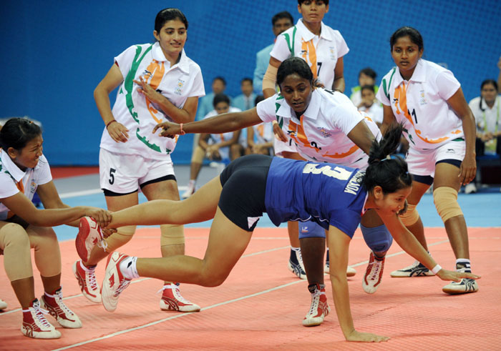
Basic Skills
Ankle Hold

Slide 31
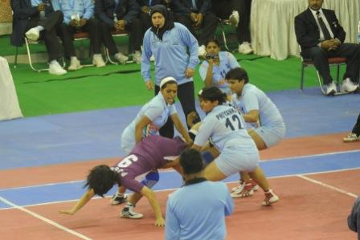
Basic Skills
Thigh Hold

Slide 32
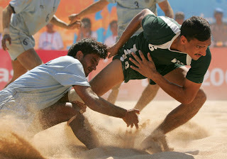
Basic Skills
Knee Hold

Slide 33
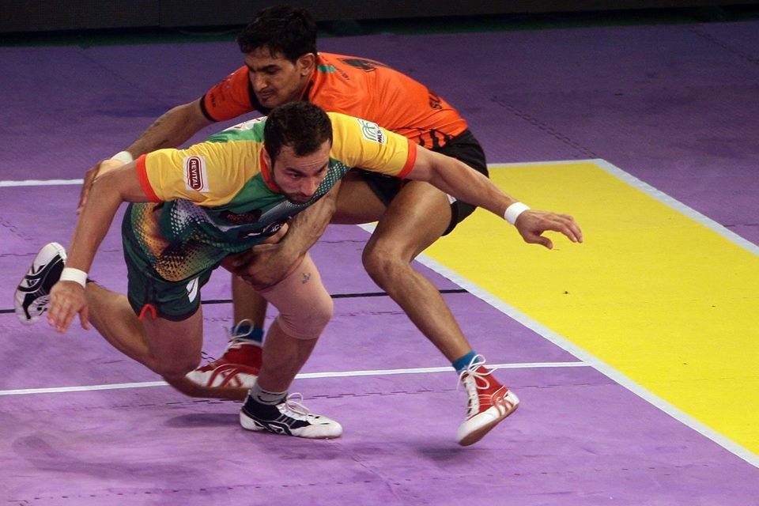
Basic Skills
Waist or Trunk Hold

Slide 34
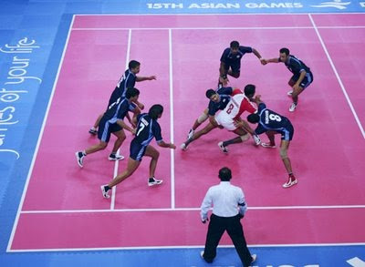
Basic Skills
Blocking

Slide 35
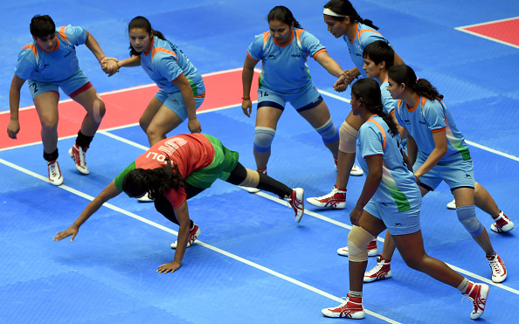
Basic Skills
Toe touch

Slide 36
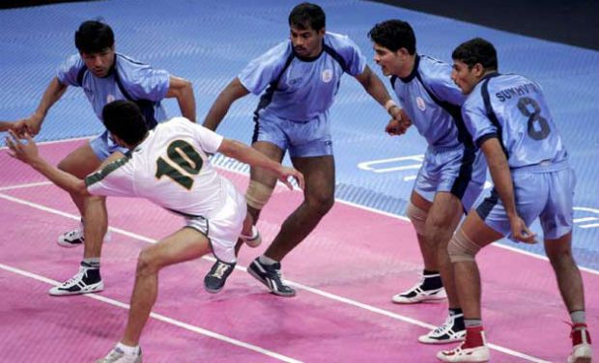
Basic Skills
Sudden leg thrust

Slide 37
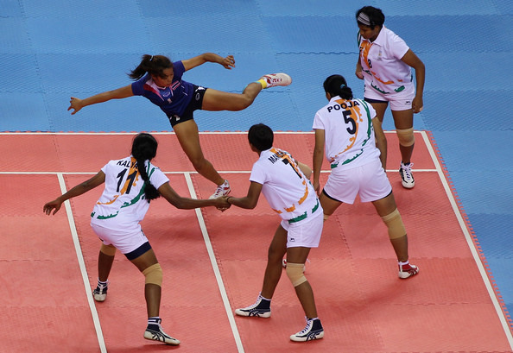
Basic Skills
Kicking - Back kick, Side kick & Curve / roll kick

Slide 38
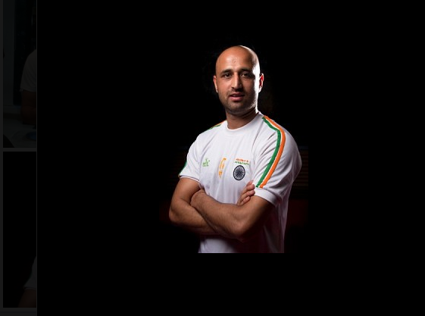
Identify the Players

Slide 39
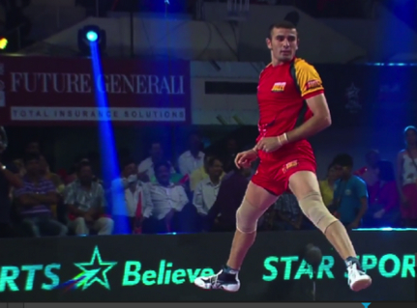
Identify the Players

Slide 40
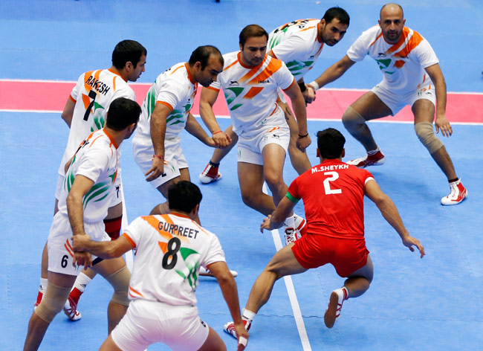
Identify the Players

Slide 41
